Slide 1



Deforestation Detection
Project title :AI-Powered Deforestation Detection Using Satellite Imagery
AICTE Student ID: STU685be2e0095751750852320
AICTE Internship ID: INTERNSHIP_1748923002683e727a876ea

Slide 2

Learning Objectives
Understand how Convolutional Neural Networks (CNNs) can classify satellite images.
Apply image preprocessing techniques for model training.
Build and deploy a Streamlit web app for real-time deforestation detection.
Explore the use of AI in environmental monitoring and SDG 15 (Life on Land).
GOAL
Source :
www.freepik.com/

Slide 3
Tools and Technology used
Programming : Python
ML Framework : TensorFlow, Keras
Image Processing : OpenCV, NumPy
Web App : Streamlit
Deployment : Localhost or GitHub
Dataset : Satellite images (Landsat, Sentinel, Kaggle)

Slide 4
Methodology
1. Data Collection
Satellite images labeled as forest and deforested are collected from Kaggle or Sentinel-2.
2. Preprocessing
Images resized to 128×128 pixels.
Normalized pixel values for better model performance.
3. Model Training
CNN architecture with two convolutional layers and one dense output layer.
Binary classification using sigmoid activation.
4. Deployment
Streamlit app for user interaction.
Upload image → preprocess → predict → display result.

Slide 5
Problem Statement:
Manual monitoring of deforestation is slow, expensive, and often inaccurate. With increasing forest loss due to illegal logging and urban expansion, there is a need for an automated system that can detect deforestation from satellite images in real time.

Slide 6
Solution:
This project uses a Convolutional Neural Network (CNN) to classify satellite images as either forested or deforested. A Streamlit web app allows users to upload images and receive instant feedback. The system can be extended to send alerts and generate heatmaps for high-risk zones.

Slide 7
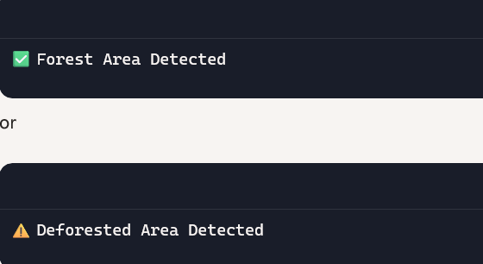
Screenshot of Output:

Slide 8
Conclusion:
AI-powered deforestation detection using satellite imagery has emerged as a transformative approach to environmental monitoring. By leveraging deep learning models such as Convolutional Neural Networks (CNNs) and U-Net architectures, these systems can accurately identify and segment areas of forest loss with high precision—often exceeding 90% accuracy. The use of semantic segmentation, multiscale feature extraction, and attention mechanisms further enhances the model’s ability to detect subtle changes across diverse terrains and vegetation types. Unlike traditional ground-based methods, AI-driven satellite analysis enables scalable, repeatable, and cost-effective monitoring across vast geographic regions. This not only facilitates real-time detection and early intervention but also empowers policymakers and conservationists to enforce regulations and promote sustainable forest management. Ultimately, such technologies play a vital role in advancing climate action, preserving biodiversity, and supporting global efforts toward environmental sustainability.

